Slide 1
Chapter 5
Bracketing Methods

Slide 2
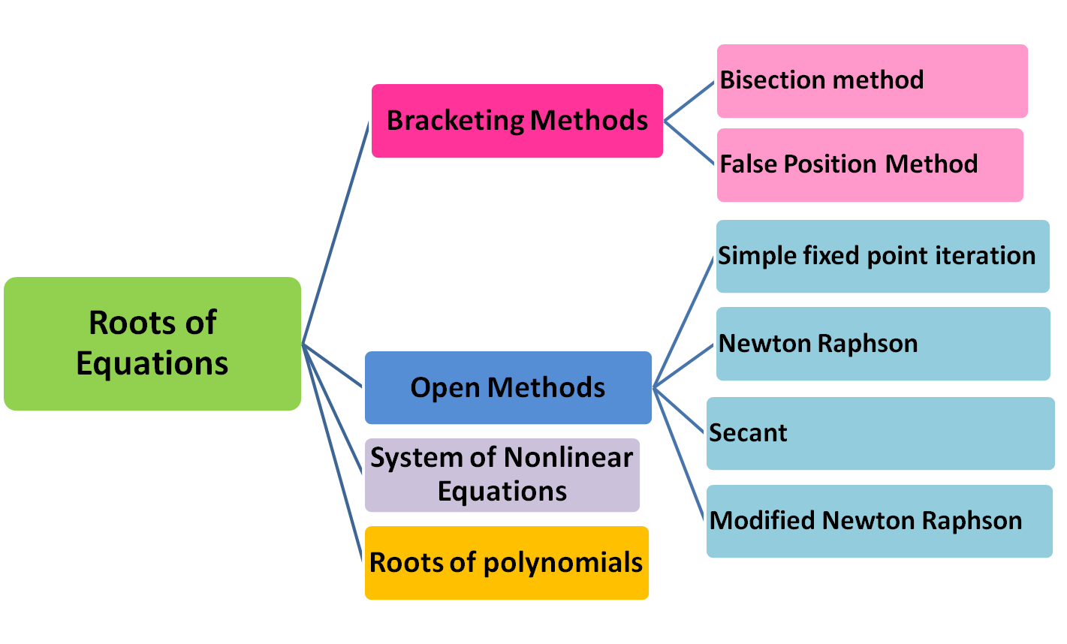

ROOTS OF EQUATIONS

Slide 3
Bracketing Methods
No roots or even number of roots
f(x)
f(x)
Odd number of roots
f(x_{l})=+ve
f(x_{l})=+ve
roots
roots
f(x_{u})=+ve
x
x
x_{l}
x_{u}
f(x_{u})=-ve
x_{l}
x_{u}
Typically changes sign in the vicinity of a root

Slide 4
Bracketing Methods (cont.)
Two initial guesses (x_{l} and x_{u}) are required for the root which bracket the root (s).
If one root of a real and continuous function, f(x)=0, is bounded by values x_{l} , x_{u} then f(x_{l}).f(x_{u}) <0.
(The function changes sign on opposite sides of the root)

Slide 5
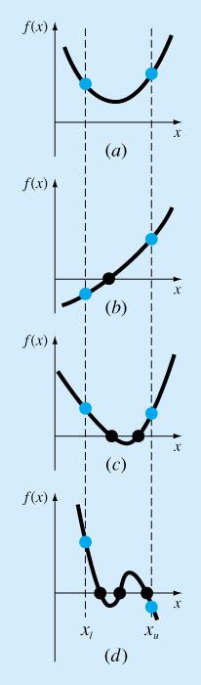
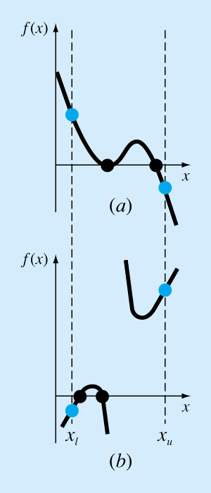
Special Cases

Slide 6
Bracketing Methods
1. Bisection Method
Generally, if f(x) is real and continuous in the interval x_{l} to x_{u} and f (x_{l}).f(x_{u})<0, then there is at least one real root between x_{l} and x_{u} to this function.
The interval at which the function changes sign is located. Then the interval is divided in half with the root lies in the midpoint of the subinterval. This process is repeated to obtained refined estimates.

Slide 7
f(x)
Step 1: Choose lower x_{l} and upper x_{u} guesses for the root such that:
  f(x_{l}).f(x_{u})<0
Step 2: The root estimate is:
  x_{r} = ( x_{l} + x_{u} )/2
Step 3: Subdivide the interval according to:
  If (f(x_{l}).f(x_{r})<0) the root lies in the lower subinterval; x_{u} = x_{r} and go to step 2.
  If (f(x_{l}).f(x_{r})>0) the root lies in the upper subinterval; x_{l} = x_{r} and go to step 2.
  If (f(x_{l}).f(x_{r})=0) the root is x_{r} and stop
x_{r} = ( x_{l} + x_{u} )/2
f(x_{u})
x_{l}
x_{r1}
x_{u}
x
f(x_{r1})
f(x_{u})
f(x)
(f(x_{l}).f(x_{r})<0): x_{u} = x_{r}
x_{r} = ( x_{l} + x_{u} )/2
f(x_{u})
f(x_{r2})
x_{l}
x_{u}
x_{r2}
x
f(x_{u})

Slide 8
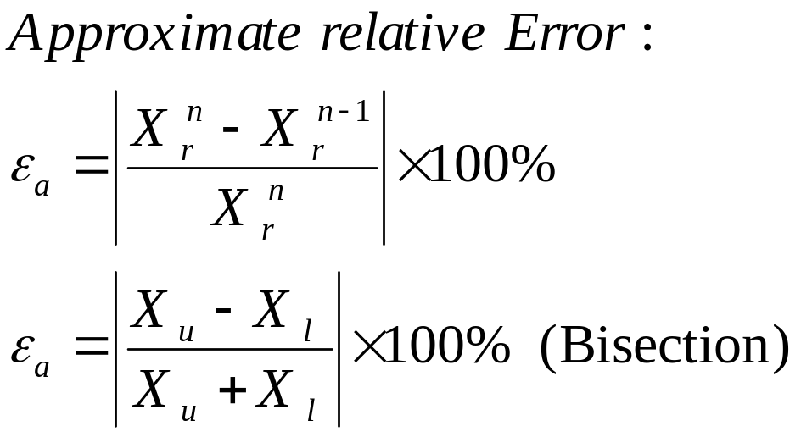
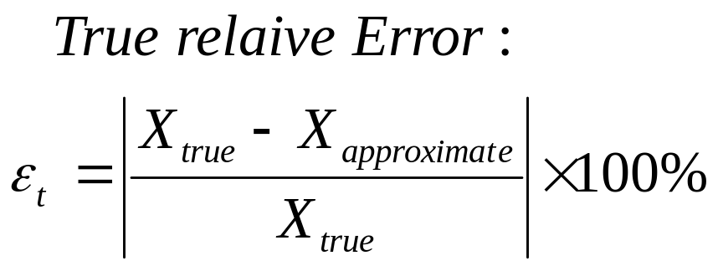
Bisection Method - Termination Criteria
For the Bisection Method ε_{a} > ε_{t}
The computation is terminated when ε_{a} becomes less than a certain criterion (ε_{a} < ε_{s})

Slide 9
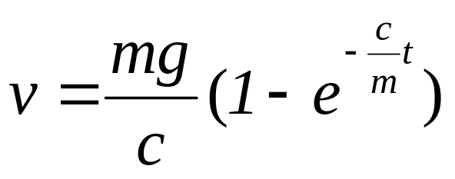
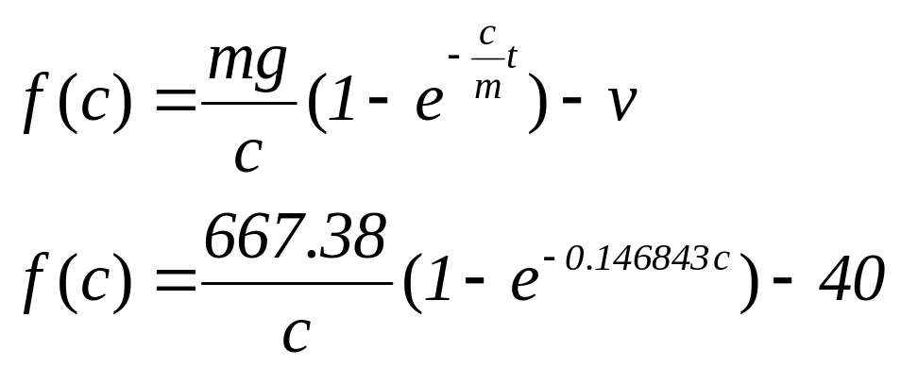
Bisection method: Example
The parachutist velocity is
What is the drag coefficient c needed to reach a velocity of 40 m/s if m = 68.1 kg, t = 10 s, g= 9.8 m/s²
f(c)
c

Slide 10
f(x)
Assume x_{l} =12 and x_{u}=16
  f(x_{l})=6.067 and f(x_{u})=-2.269
The root: x_{r}=(x_{l}+x_{u})/2= 14
Check f(12).f(14) = 6.067•1.569=9.517 >0;
the root lies between 14 and 16.
Set x_{l} = 14 and x_{u}=16, thus the new root x_{r}=(14+ 16)/2= 15
Check f(14).f(15) = 1.569•-0.425= -0.666 <0;
the root lies bet. 14 and 15.
Set x_{l} = 14 and x_{u}=15, thus the new root x_{r}=(14+ 15)/2= 14.5
and so on…...
6.067
1.569
x
12
14
16
-2.269
f(x)
(f(12).f(14)>0): x_{l} = 14
1.569
15
14
x
16
-0.425
-2.269

Slide 11
Bisection method: Example
In the previous example, if the stopping criterion is ε_{t} = 0.5%; what is the root?
Iter. X_{l} X_{u} X_{r} ε_{a}% ε_{t}%
1 12 16 14 5.279 --
2 14 16 15 6.667 1.487
3 14 15 14.5 3.448 1.896
4 14.5 15 14.75 1.695 1.204
5 14.75 15 14.875 0.84 0.641
6 14.74 14.875 14.813 0.422 0.291

Slide 12
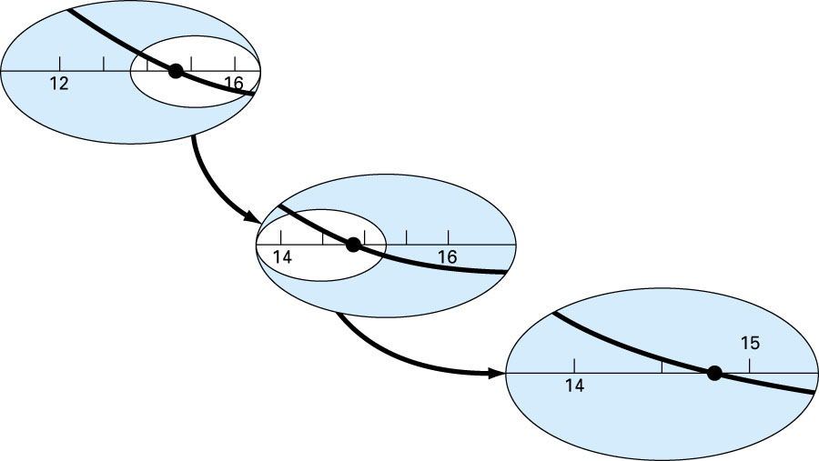
Bisection method

Slide 13
Flow Chart –Bisection
Start
Input: x_{l} , x_{u} , ε_{s}, maxi
f(x_{l}). f(x_{u})<0
False
i=0
ε_{a}=1.1ε_{s}
while
ε_{a}> ε_{s} &
i <maxi
False
Print: x_{r} , f(x_{r} ) ,ε_{a} , i
Stop

Slide 14
x_{u}+x_{l} =0
True
Test=f(x_{l}). f(x_{r})
Test=0
True
ε_{a}=0.0
Test<0
True
x_{u}=x_{r}
False
x_{l}=x_{r}

Slide 15
Bracketing Methods
2. False-position Method
The bisection method divides the interval x_{l} to x_{u} in half not accounting for the magnitudes of f(x_{l}) and f(x_{u}). For example if f(x_{l}) is closer to zero than f(x_{u}), then it is more likely that the root will be closer to f(x_{l}).
False position method is an alternative approach where f(x_{l}) and f(x_{u}) are joined by a straight line; the intersection of which with the x-axis represents and improved estimate of the root.

Slide 16
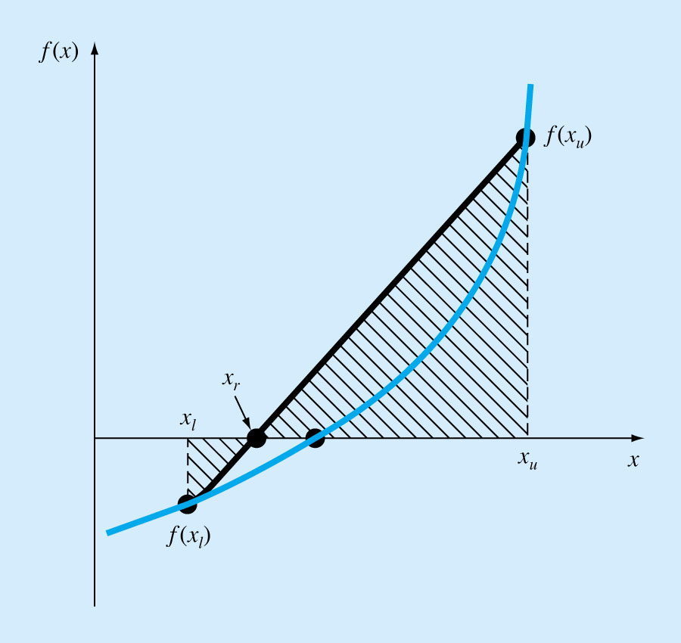
2. False-position Method
False position method is an alternative approach where f(x_{l}) and f(x_{u}) are joined by a straight line; the intersection of which with the x-axis represents and improved estimate of the root.

Slide 17
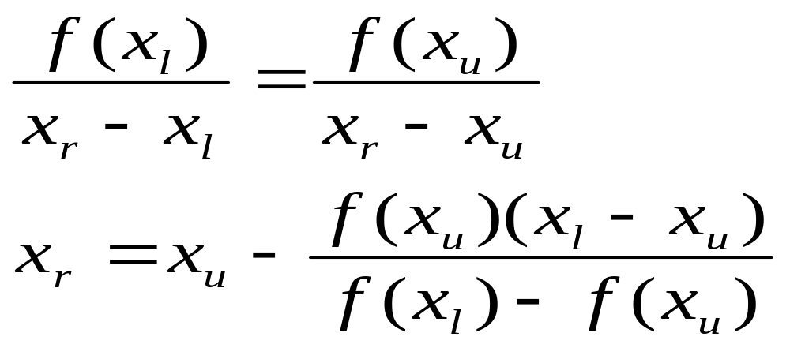
False-position Method -Procedure
f(x)
f(x_{u})
x_{l}
x_{r}
x_{u}
x
f(x_{l})
f(x_{r})

Slide 18
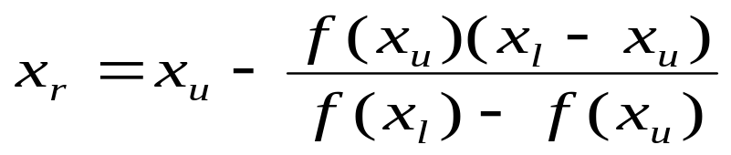
False-position Method -Procedure
Step 1: Choose lower x_{l} and upper x_{u} guesses for the root such that: f(x_{l}).f(x_{u})<0
Step 2: The root estimate is:
Step 3: Subdivide the interval according to:
  If (f(x_{l}).f(x_{r})<0) the root lies in the lower subinterval; x_{u} = x_{r} and go to step 2.
  If (f(x_{l}).f(x_{r})>0) the root lies in the upper subinterval; x_{l} = x_{r} and go to step 2.
  If (f(x_{l}).f(x_{r})=0) the root is x_{r} and stop

Slide 19

False position method: Example
The parachutist velocity is
What is the drag coefficient c needed to reach a velocity of 40 m/s if m =68.1 kg, t =10 s, g= 9.8 m/s²
f(c)
c

Slide 20
False position method: Example
Assume x_{l} = 12 and x_{u}=16
  f(x_{l})= 6.067 and f(x_{u})= -2.269
The root: x_{r}=14.9113
f(12) . f(14.9113) = -1.5426 < 0;
The root lies bet. 12 and 14.9113.
Assume x_{l} = 12 and x_{u}=14.9113, f(x_{l})=6.067 and f(x_{u})=-0.2543
The new root x_{r}= 14.7942
This has an approximate error of 0.79%
f(x)
6.067
14.91
x
12
16
-2.269

Slide 21
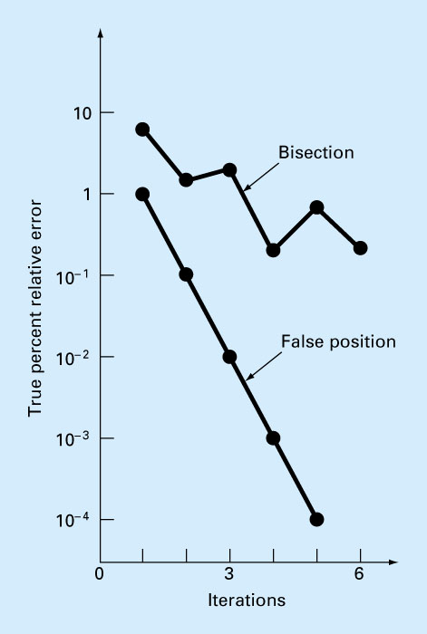
False position method: Example

Slide 22
Flow Chart –False Position
Start
Input: x_{l} , x₀ , ε_{s}, maxi
f(x_{l}). f(x_{u})<0
False
i=0
ε_{a}=1.1ε_{s}
while
ε_{a}> ε_{s} &
i <maxi
False
Print: x_{r} , f(x_{r} ) ,ε_{a} , i
Stop

Slide 23
i=1
or
x_{r}=0
True
Test=f(x_{l}). f(x_{r})
Test=0
True
ε_{a}=0.0
Test<0
True
x_{u}=x_{r}
x_{r0}=x_{r}
False
x_{l}=x_{r}
x_{r0}=x_{r}

Slide 24
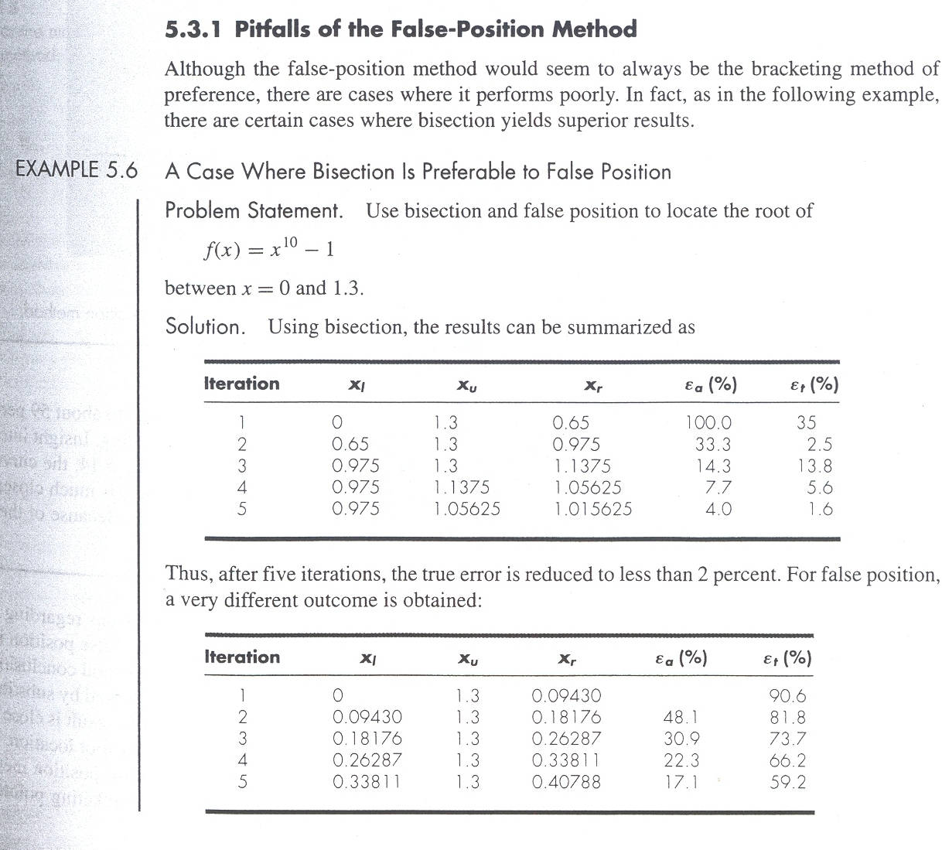
False Position Method-Example 2

Slide 25
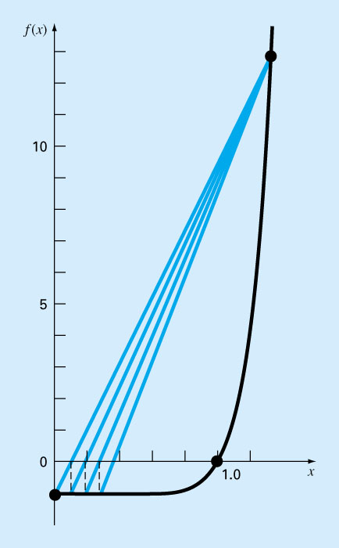
False Position Method - Example 2

Slide 26
Pitfalls of the False Position Method
Although a method such as false position is often superior to bisection, there are some cases (when function has significant curvature) that violate this general conclusion.
In such cases, the approximate error might be misleading and the results should always be checked by substituting the root estimate into the original equation and determining whether the result is close to zero.
Major weakness of the false-position method: its one sidedness That is, as iterations are proceeding, one of the bracketing points will tend stay fixed which lead to poor convergence.

Slide 27
Modified Fixed Position
One way to mitigate the "one-sided" nature of false position is to make the algorithm detect when one of the bounds is stuck. If this occur, the function value at the stagnant bound is divided in half. This is thought to fasten the convergence.

